Slide 1
Software Development Project
AAPP006-4-2 & Version 1
Entity Relationship Model

Slide 2
Topic & Structure of The Lesson
ERD notation
Relationship Participation
Relationship Degree
Composite Entities

Slide 3
Learning Outcomes
At the end of this topic, You should be able to
Construct an entity relational model based on a case study

Slide 4
Key Terms You Must Be Able To Use
If you have mastered this topic, you should be able to use the following terms correctly in your assignments and exams:
Crow’s foot
Chen’s model
Unary / recursive relationship
Binary relationship
Ternary relationship
Quaternary relationship

Slide 5
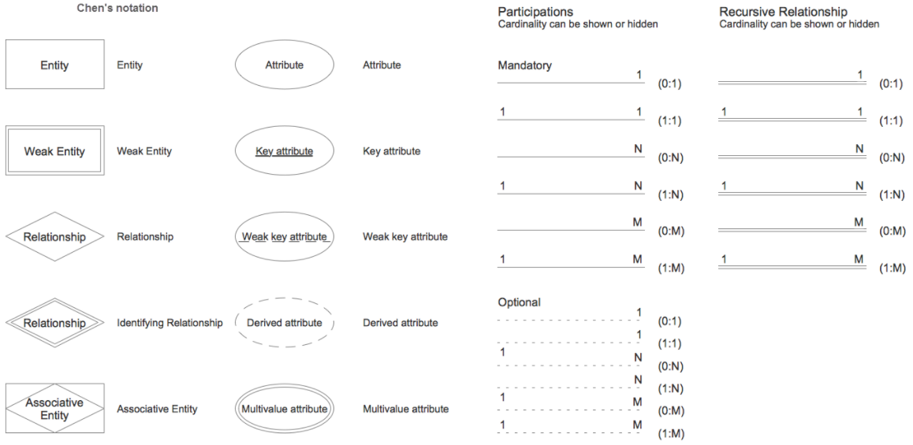

Slide 6
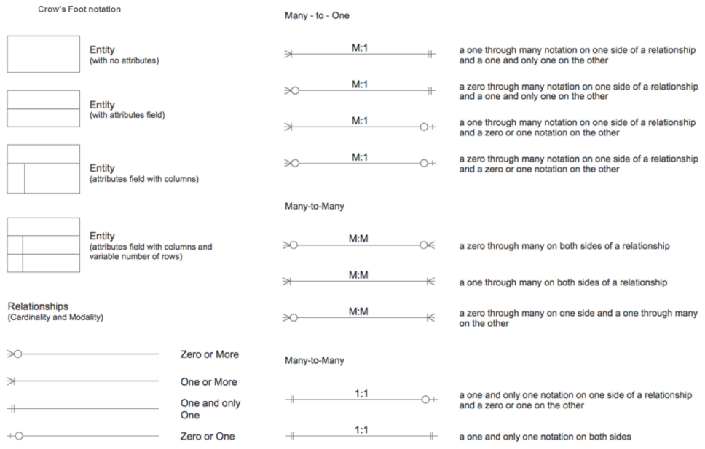

Slide 7
Relationship Participation
Optional participation
One entity occurrence does not require corresponding entity occurrence in particular relationship
Mandatory participation
One entity occurrence requires corresponding entity occurrence in particular relationship

Slide 8
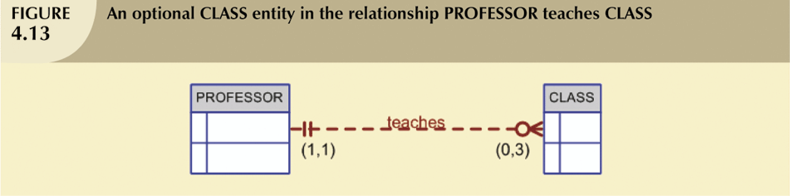
Relationship Participation (continued)
CLASS is optional to PROFESSOR

Slide 9
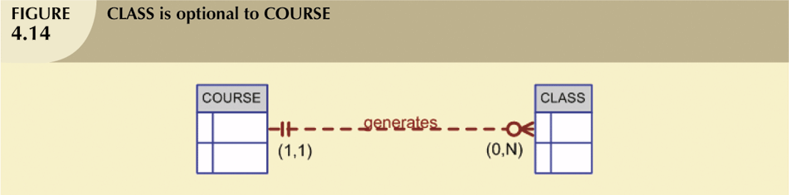
Relationship Participation (continued)

Slide 10
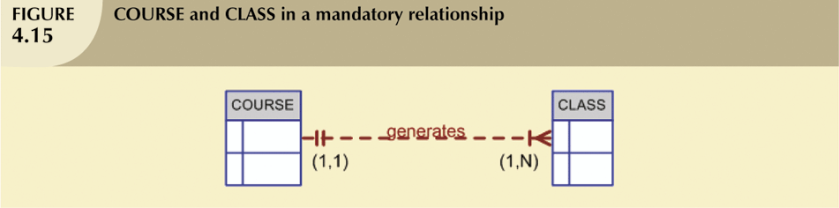
Relationship Participation (continued)

Slide 11
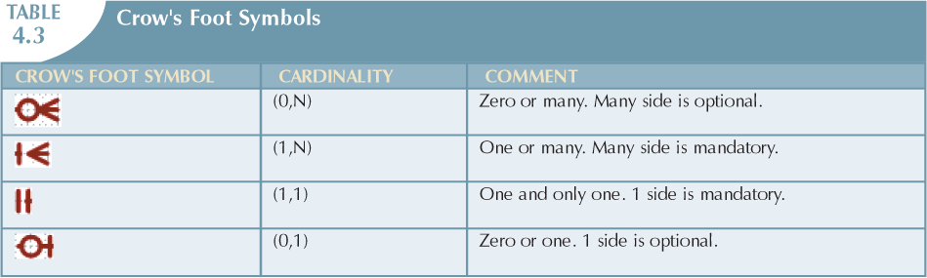
Relationship Participation (continued)

Slide 12
Relationship Degree
Indicates number of entities or participants associated with a relationship
Unary relationship
Association is maintained within single entity
Binary relationship
Two entities are associated
Ternary relationship
Three entities are associated
Quaternary relationship
Four entities are associated

Slide 13

Binary Relationship called POwns

Slide 14
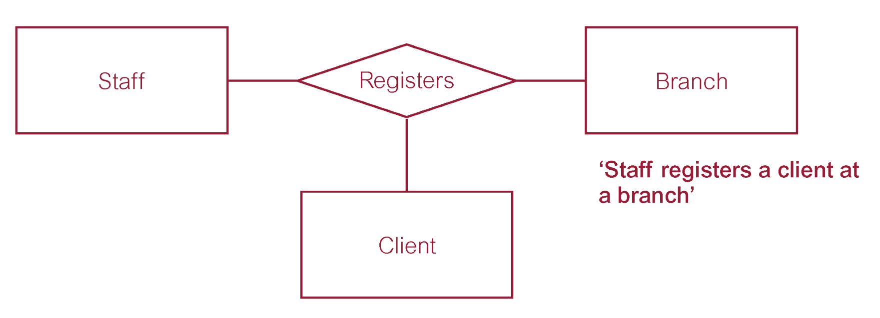
Ternary Relationship called Registers

Slide 15
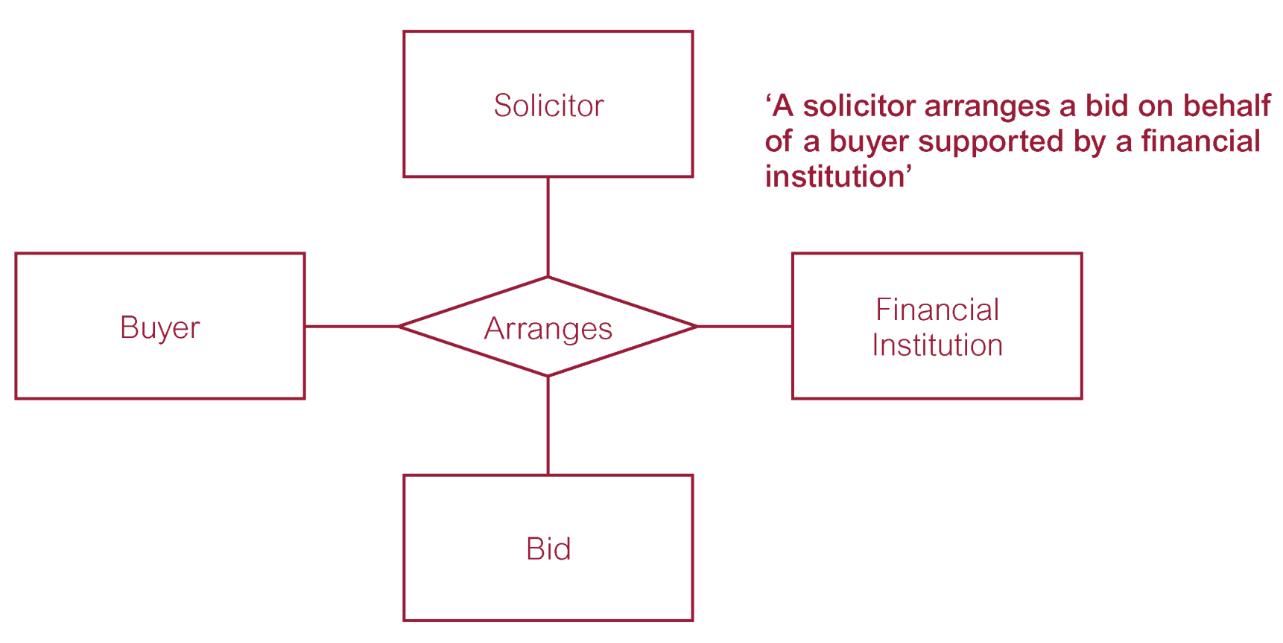
Quaternary Relationship called Arranges

Slide 16
Recursive Relationships
Relationship can exist between occurrences of the same entity set
Naturally found within unary relationship

Slide 17
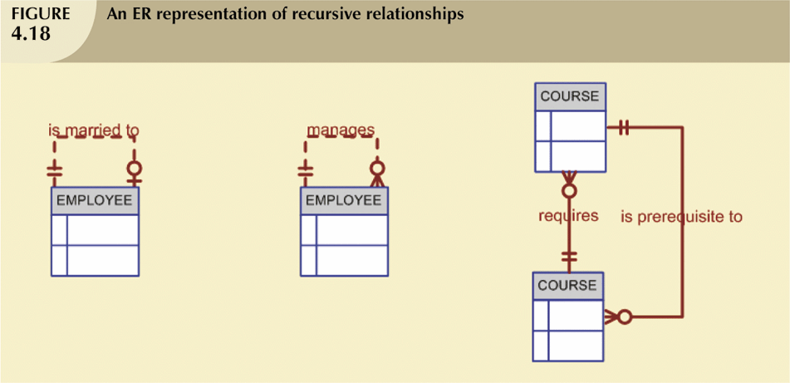
Recursive Relationships (continued)

Slide 18
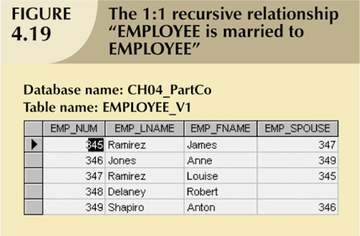
Recursive Relationships (continued)

Slide 19
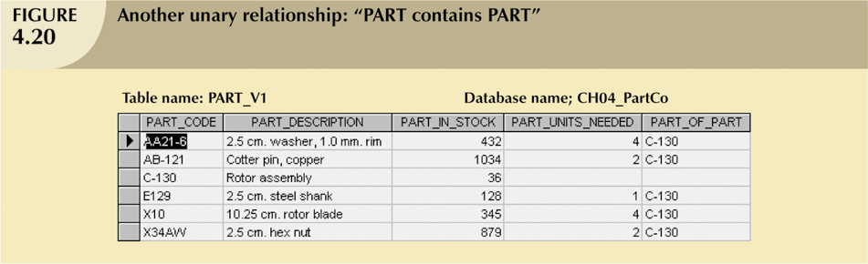
Recursive Relationships (continued)

Slide 20
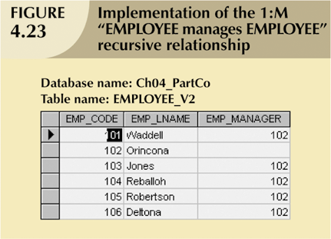
Recursive Relationships (continued)

Slide 21
Composite Entities
Also known as bridge entities
Composed of primary keys of each of the entities to be connected
May also contain additional attributes that play no role in connective process

Slide 22
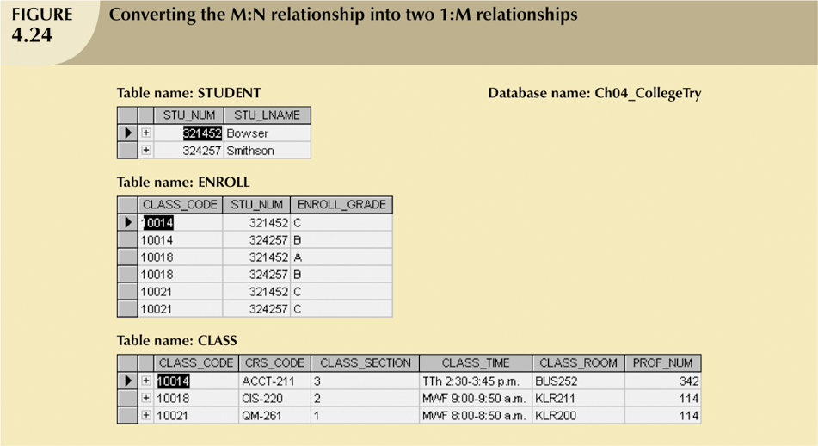
Composite Entities (continued)

Slide 23
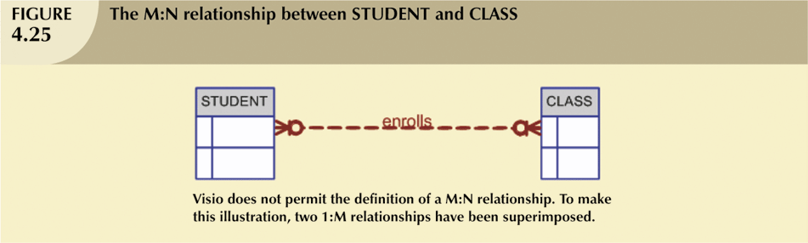
Composite Entities (continued)

Slide 24
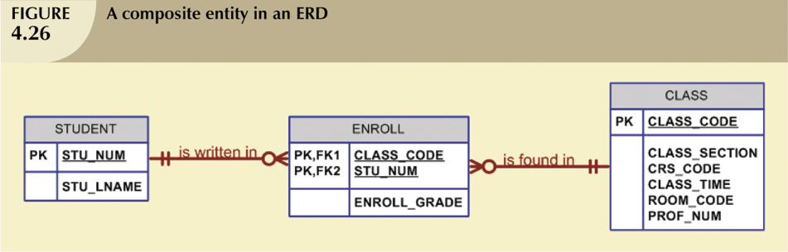
Composite Entities (continued)

Slide 25
Quick Review Question
Provide 1 example each for the relationship degree below
Unary / recursive
Binary
Ternary
Quaternary

Slide 26
Summary of Main Teaching Points
Entity relationship (ER) model
Uses ERD to represent conceptual database as viewed by end user
Includes connectivity and cardinality notations
Connectivities and cardinalities are based on business rules
In ERM, M:N relationship is valid at conceptual level

Slide 27
Question and Answer Session
Q & A

Slide 28
What we will cover next
System Testing

